Slide 1

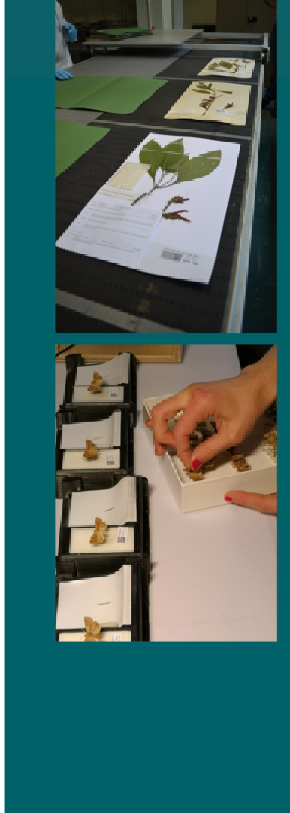
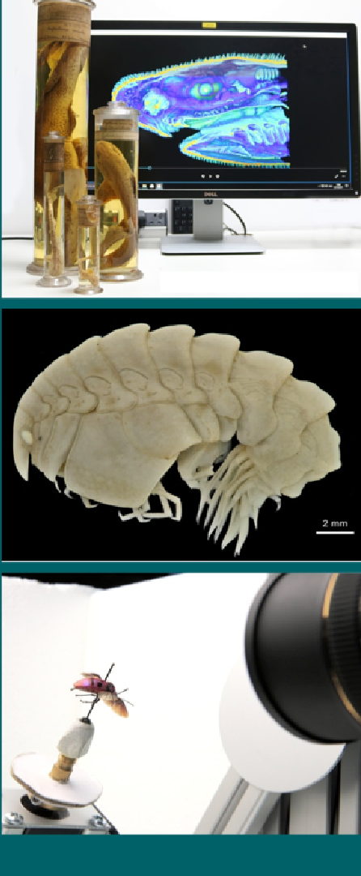
A linked project of
‘openDS’ – A New Standard for Digital Specimens and Other Natural Science Digital Object Types
Alex R Hardisty, Cardiff University
Keping Ma, Institute of Botany, Chinese Academy of Sciences
Gil Nelson, Florida State University
Jose Fortes, University of Florida
Biodiversity_Next, ST74 37033 doi: 10.3897/biss.3.37033 Leiden, 22-25 October 2019

Slide 2
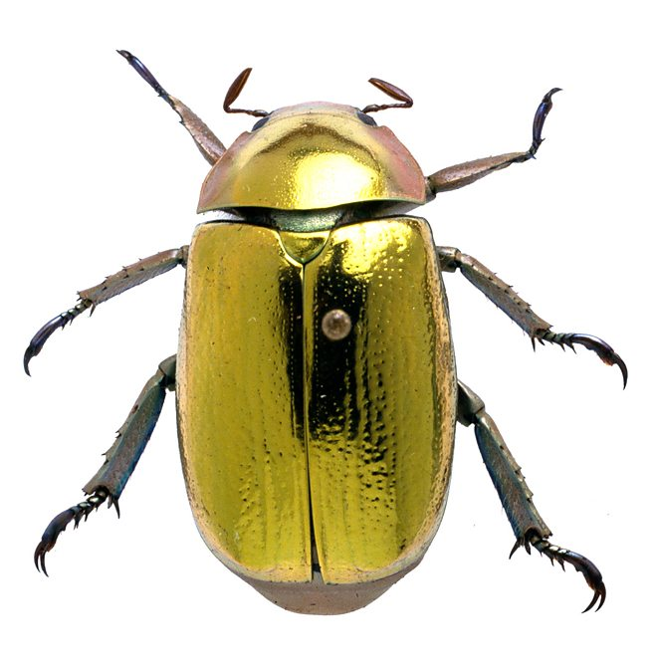







What’s in a museum specimen?
Genomic data
Biochemical data
Morphological data
Geographical data
Taxonomic Information
Species Interactions data
Ecological data
Slide by Dimitris Koureas, DiSSCo Coordination and Support Office
Notes:
Museum specimens are rich sources for many kinds of data.

Slide 3
Digitization initiatives around the World, linking dispersed data and lowering barriers to access
~1.5billion specimens in Europe 25,000 researchers travel every year to physically access scientific collections.
800,000 objects packed and shipped.
National Specimen Information Infrastructure (NSII) is one of 23 National Science & Technology infrastructures of China. ~15 million specimen records, ~6 million media files.
U.S. museums hold ~1 billion specimens in 1600 collections. Digitized data are accessible via ~121 million transcribed records and ~32 million media files in iDigBio portal.
Annual public cost > €70M
Notes:
There are multiple initiatives around the world tackling digitization of specimens in collections. Here are three examples; there are others too. Less than 10% digitized so far. Whichever currency you choose, the public cost of loans and visits is hundreds of millions per year and the system is slow and inefficient. Digitization aims to widen access and change working practice.

Slide 4
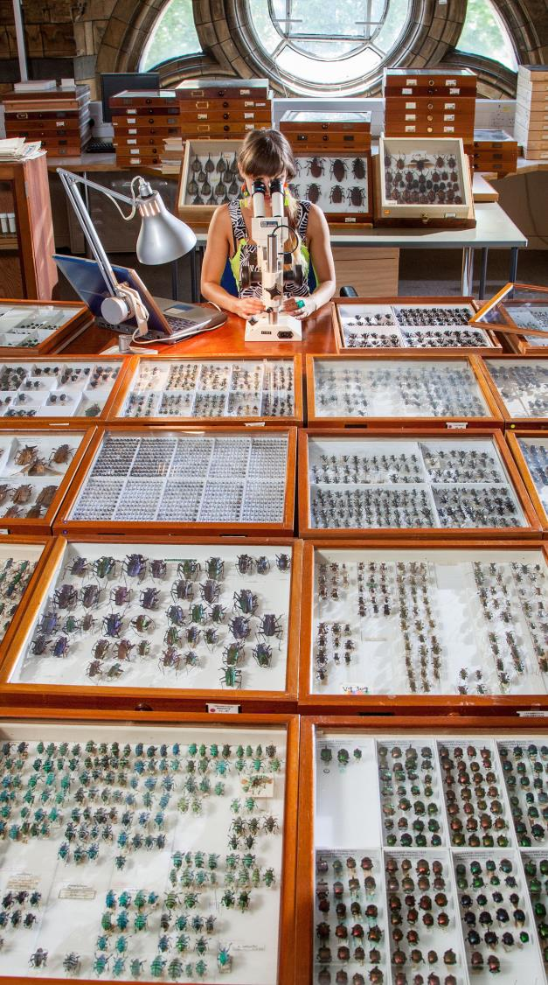
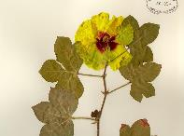
Specimens at the centre
Sequence
Occurrence
Taxon
Interaction
Images
Taxon
Concept
Gene
Specimen
Taxon Name
All data classes unambiguously linked to the physical objects they derive from
Collection
Trait
Publication
In future data infrastructures this anchoring function will be performed by a Digital Specimen
Notes:
Specimens are the carefully curated hard evidence about our natural world, often surrounded by other data derived from them.
In future data infrastructures, digital specimens will perform an anchoring function for all this data.
This is key to notions of extended specimens and next generation collections.

Slide 5

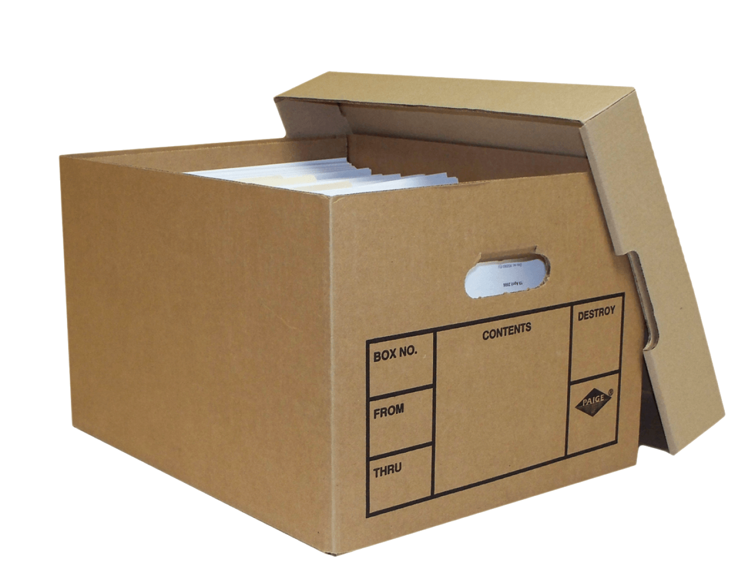
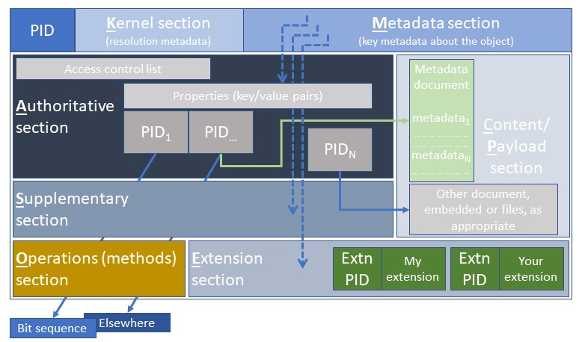
A Digital Specimen (DS)
Is a container, a box of data, information and links to other data about a physical specimen
Technically, it’s a digital object with:
A globally unique persistent identifier (PID)*
A type definition that defines its structure#
Box No.
Metadata outside, content inside
Proposed structure
*Resolvable via well-known resolver #Accessible via a type registry

Slide 6
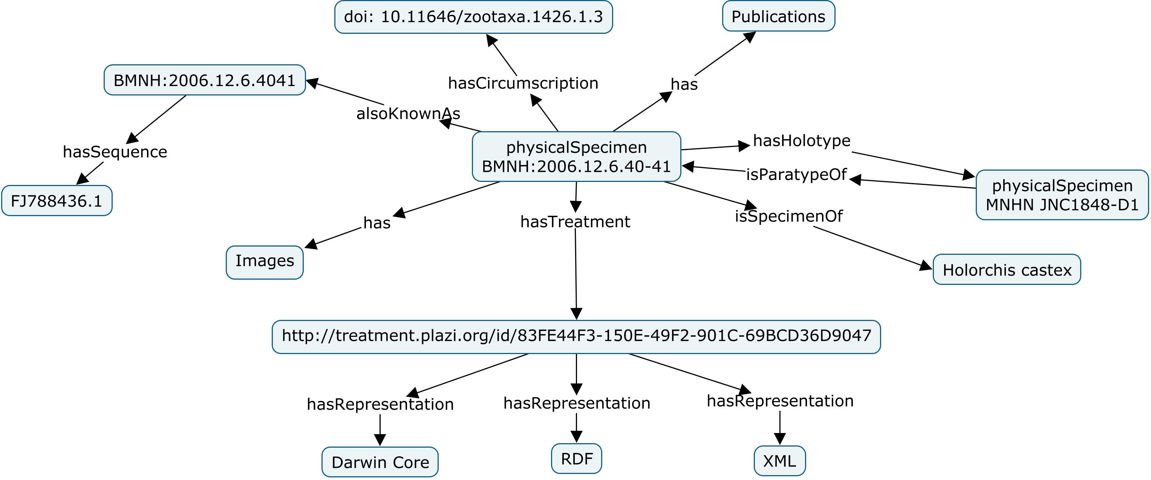
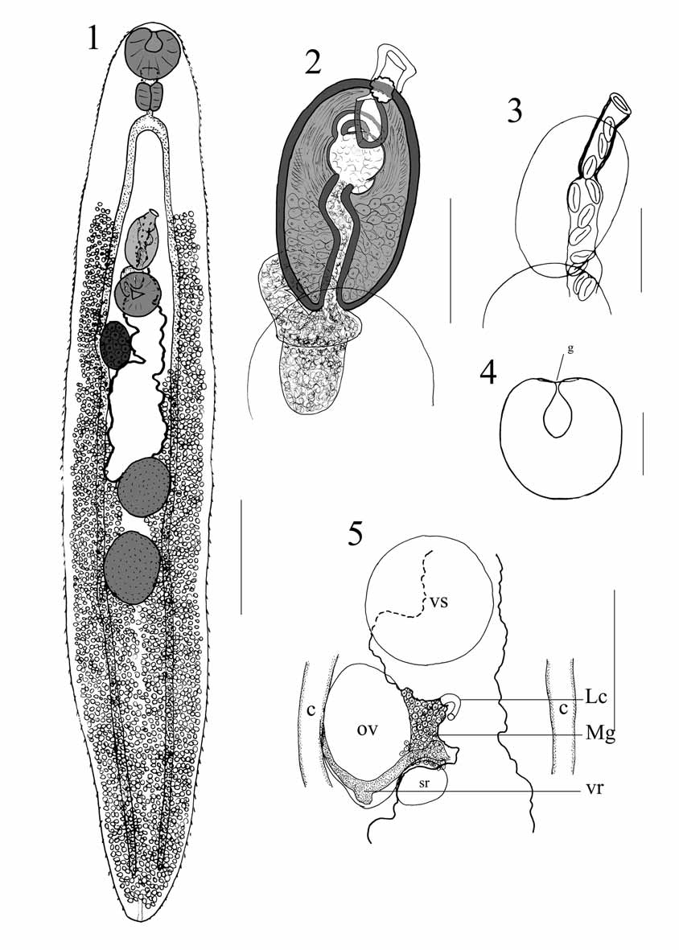
digitalSpecimen id: 20.5000.1025/gqzdomzr (Nb. id is illustrative only.)
http://www.catalogueoflife.org/col/ details/species/id/828cbc4eecaa24 02b09cd9223754171e
serialized as JSON
{"type":"DigitalSpecimen","attributes":{"content":{"id":"20.5000.1025/6e2b07784b8f608d9e37","creationdatetime":"","creator":"","midslevel":2,"scientificName":"Holorchis castex Bray & Justine","country":"New Caledonia","locality":"Rocher a la voile", "decimalLat/Long":[-22.3,166.42],"recordedBy":"J L. Justine","collectionDate":"2006-06-01“, "catalogNumber":"2006.12.6.40-41","otherCatalogNumbers":"NHMUK:ecatalogue:7072219", "institutionCode":"NHMUK","collectionCode":"ZOO, Parasitic worms", "stableIdentifier":"https://data.nhm.ac.uk/object/e90b81bc-1642-47ca-b587-6aa8885cd6a0/1558569600000","physicalSpecimenId":"013258549","Annotations":"Type status = paratype. Holotype = MNHN JNC 1848 –D 1","gbifId":"https://www.gbif.org/occurrence/1826086349","catOfLifeReference":"http://www.catalogueoflife.org/col/details/species/id/828cbc4eecaa2402b09cd9223754171e","literatureReference":"https://doi.org/10.5281/zenodo.175744","treatmentbank":"http://tb.plazi.org/GgServer/html/03BA87825543FFBFD895FD27FAE1DDAD ","enaBiosample":"None available","enaSequence":"https://www.ebi.ac.uk/ena/data/view/FJ788436","LiteratureReferenceRelated":"https://doi.org/10.2478/s11686-009-0045-z"}},"elements":[]}
A simple Digital Specimen
Bray, R.A., & Jean-Lou J. "Holorchis castex n. sp. … …" Zootaxa 1426.1 (2007): 51-56. doi: 10.11646/zootaxa.1426.1.3
Notes:
A simple example – a parasitic worm in fish - that contains data about the actual specimen, as well as links to other data about it,
which can be represented as JSON for transfer between systems, as well as for application processing and entry into databases.

Slide 7
‘Findable, Accessible, Interoperable, Reusable’ FAIR Digital Objects for FAIR Science
FDF = Framework for FAIR digital objects
GUPRI = Globally unique, persistent and resolvable identifier
Recommended: Wittenburg et al. 2019. Digital Objects as Drivers towards Convergence in Data Infrastructures. doi: 10.23728/b2share.b605d85809ca45679b110719b6c6cb11
Notes:
Digital Specimens are implicitly ‘FAIR digital objects’ – that is, with persistent identifier, metadata and a type definition they are findable, accessible, interoperable and reusable. We need a type definition for Digital Specimens.

Slide 8
Seamlessly organise digital access across multiple collections, indexing them globally and uniquely
Virtual collection(s) oﬀer possibilities for wider, more ﬂexible, and FAIR Science* for research/policy uses:
Recognising curatorial work, as well as performing that in the community
Annotating with latest taxonomic treatments
Understanding variations
Working with linked information
Such as images, DNA sequences, traits and chemical analyses
Supporting regulatory processes
Health, food, security, sustainability and environmental change
Educational uses
*FAIR Science – enfolds open science, also addressing anxieties of sensitive data and free-gratis use of data
Notes:
Why is this useful? Because it allows us to …

Slide 9
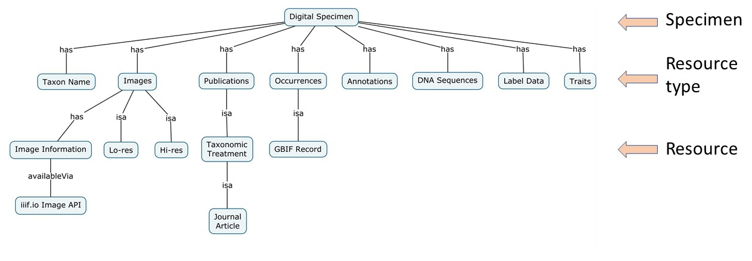
Many related object types to define
DigitalSpecimen
Collection
Gathering
StorageContainer
Presentation
SpecimenCategory
Images
Interpretations and annotations
Link packet
Taxonomic concept
Researchers and collectors
Organisations
Loans, visits, access requests
Extended operations
History of actions (provenance)
Notes:
There are many different object types to define, as illustrated by the examples here, which leads us to the need for …

Slide 10
Creating a new standard for “open Digital Specimens” (openDS)
Builds on concepts from ABCD 3.0, EFG extension for geo-sciences, and Darwin Core.
cf. Integrating ABCD and DarwinCore, Blum et al.
Roots in OBO Foundry ontologies, extending where necessary
Biological Collections Ontology (BCO); Ontology for Biomedical Investigations (OBI); Basic Formal Ontology (BFO); Information Artifact Ontology (IAO).
‘digitization_event’ as new subclass of ‘planned_process’ (OBI:0000011) alongside ‘specimen_collection_process (OBI:0000659), leading to new class ‘digital specimen’, being ‘a result of a digitisation event’.
Data type definition(s) according to RDA* Data Type Model
Serializes object content to speciﬁc format/representation (JSON) for exchange and processing purposes.
* RDA = Research Data Alliance
Notes:
… creating a new standard, openDS to provide the type definitions we need.
There are questions about how to precisely situate new classes in existing ontologies but these are resolvable.

Slide 11
Summary
Specimens in natural science collections are rich sources of and anchors for a wide variety of associated data types.
DiSSCo, iDigBio and NSII are typical digitization initiatives.
Digital Specimens (DS) represent specimens in cyberspace, acting as surrogates for physical specimens.
DS can be created, processed and moved between information systems in the new world of ‘FAIR Science’.
DS must be standardized for exchange between systems.
We propose the creation of a new TDWG standard for open Digital Specimens that we name as openDS.

Slide 12
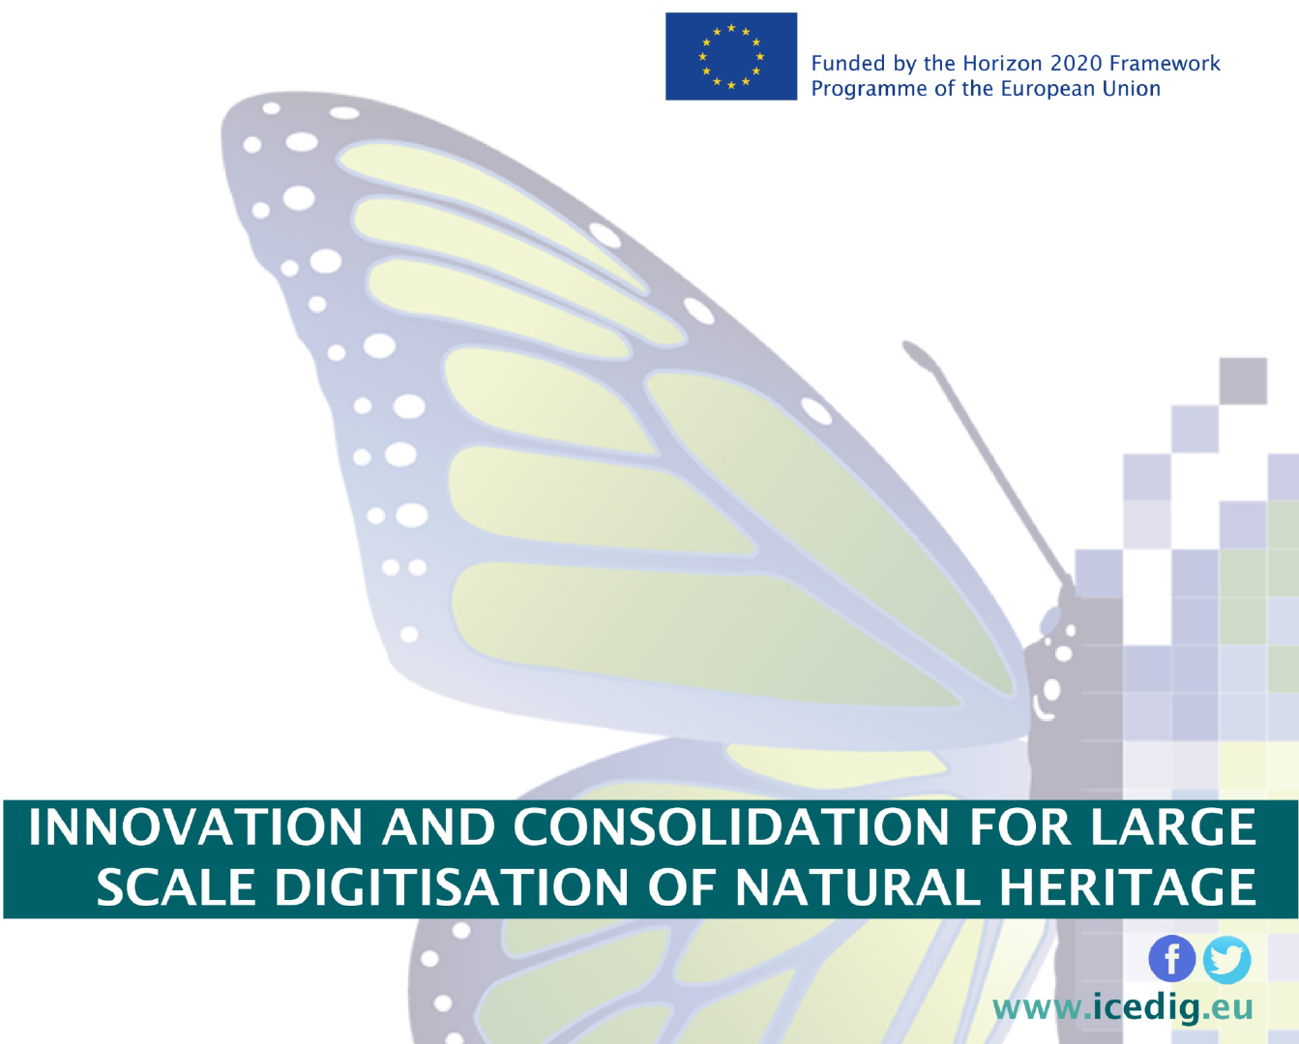
THANK YOU FOR YOUR ATTENTION!

